Slide 1

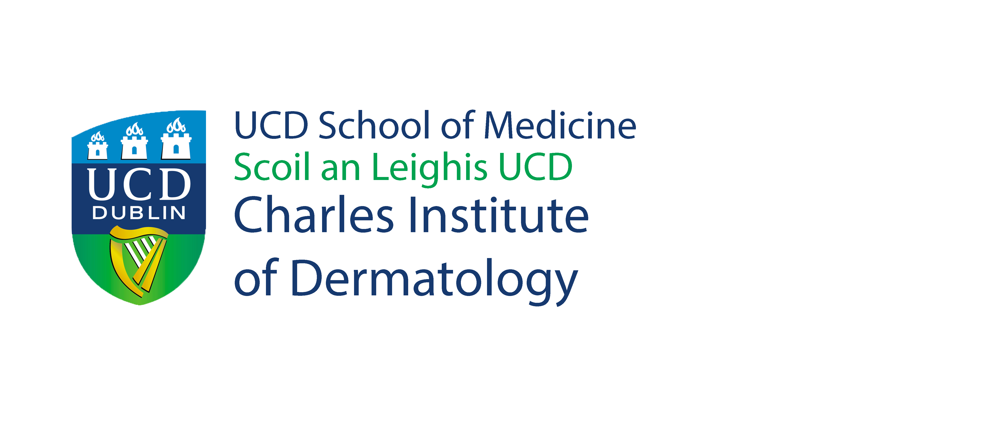



Ireland’s National Dermatology
Research & Education Centre
The Charles Institute Seminar Series
Wednesday 19th October 2022 @ 12 noon
Charles Seminar Room & Online via Zoom
Bacterio-therapy for the Management of Staphylococcus Aureus in Eczema’
Catherine O’Neill, PhD
The University of Manchester, UK.
BIO: Cath O’Neill received both her bachelor's degree and PhD from the University of Wales, where she studied bacterial biochemistry. Subsequently, she was a research fellow at the Uni. of Leeds for 5yrs before joining the Uni. of Manchester as a lecturer. She is now Prof. of Translational Dermatology. Her interests are in understanding the relationship between the skin and its microbiota and how bacteria and their products can be used for treatment of skin in health & disease. Her lab has a very translational focus and takes basic findings into human studies via spin-out companies, e.g., Curapel (2014) and SkinBiotherapeutics PLC (2017). Both companies have products on the market that help people manage skin conditions such as eczema and psoriasis.
Abstract: Atopic dermatitis (AD) is the commonest form of eczema and currently affects around 20% of the paediatric population in the western world. The disease is characterised by intermittent flare-ups of red, itchy and dry skin presenting on the hands, back of the knees, inner elbows, face and scalp although any area of the body can be affected. One of the major initiators of AD flares is infection of the skin with Staphyloccus aureus. Current treatments include antibiotics to kill the organism. However, with growing concerns about antibiotic resistant, there is an unmet need for new approaches to management of S. aureus.
We are exploring whether human microbiome bacteria are a viable alternative to antibiotics for control of S. aureus infection. Here, I will present evidence that lysates from L. rhamnosus GG (LGG) can inhibit adhesion of S. aureus to keratinocytes and to human skin in organ culture. Furthermore, LGG can boost skin’s own antimicrobial defenses and increase skin barrier function in vivo. These data suggest that LGG as well as others currently under investigation, may hold promise as a novel approach to AD management and potentially other S. aureus infections.
  *The Charles Institute Seminar Series is kindly supported by RELIFE. RELIFE had no input into the content of the Series.

